Slide 1
Demo

Slide 2
Safety Review Assistant
The review of requirements, plans and standards, implementation artefacts, tests and all associated documentation, requires SQEP, knowledge of plans and standards, work instructions, tool experience and project context.
Reviews are necessary to ensure that the correct quality of artefact is produced and that is functions as stated, therefore human review remains crucial.
The opportunity here, is acceleration of this process, through automatic analysis of all pertinent information, included as a “skill”.

Slide 3
What a solution could look like
Traditional, or AI enabled processes are completed to produce an artefact.
At the CI/CD level, submission of a Pull Request, could trigger an automatic AI review, which checks against related documentation, traces and against the process.
When peer reviewers/QA/IV&V access confluence, this AI feedback is made available, immediately identifying low level, obvious and complex issues for originator action.
This removes the dead time before the originator can receive initial comments, providing immediate feedback.

Slide 4
How this can be achieved
Option 1: Electra API access, facilitated through a simple UI. Document context, reviewer skills, and associated standards/artefacts are provided as context within a prompt. (Low effort, cost scales with Electra usage charges)
Option 2: Finding a route (with security) to local, team based deployment of a machine, hosting an LLM and orchestration framework, which is queried in a similar manner to Electra, allowing greater customisation and potentially use of higher classification data. (Greatest Effort and cost)
Option 3: Improve access to Copilot to allow document upload, gated behind SQEP training, to increase the capability of competent, safe engineers. (Lowest effort, cost unknown, security implications)

Slide 5
Benefits to be obtained
Traceability analysis can be performed automatically and verifiably.
Spelling and grammar error detection is near complete, allowing focus on more meaningful components.
New engineers become familiar with the plans and standards, as well as with the issues which are common, to each artefact.
Review lead time is eliminated, through the provision of upfront comments.

Slide 6
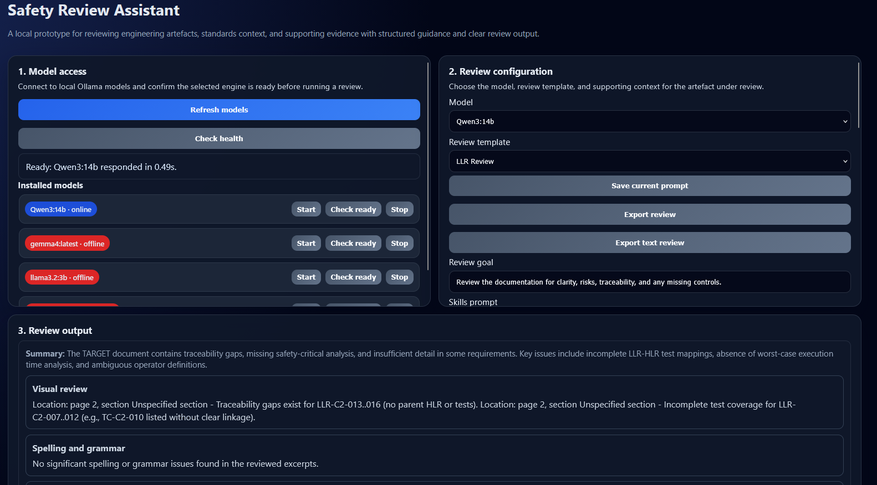

Slide 7
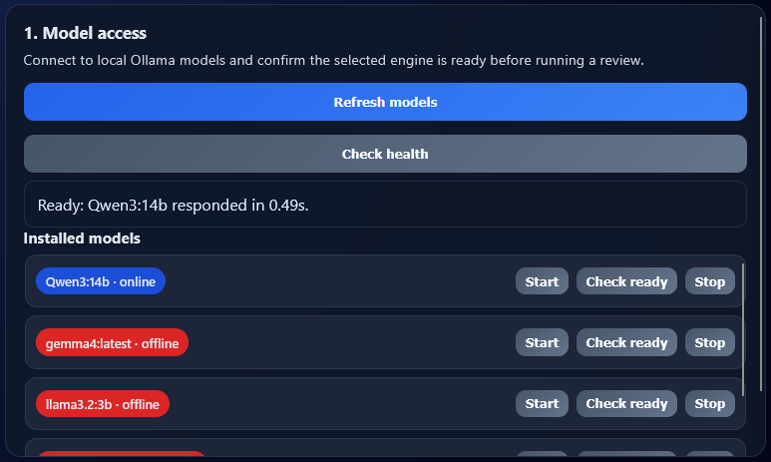

Slide 8
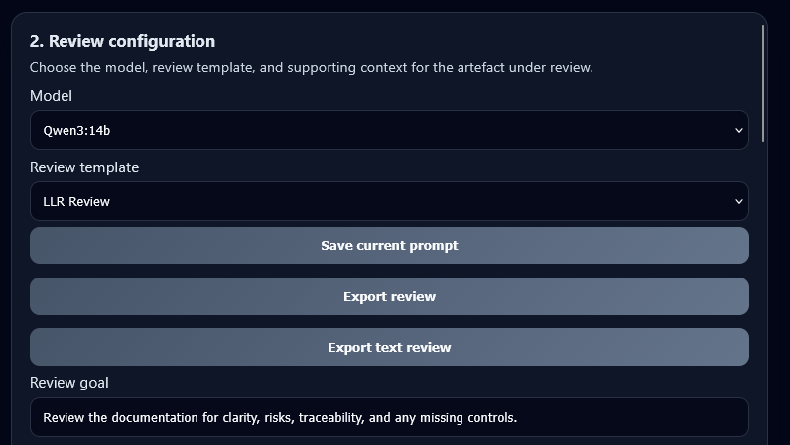
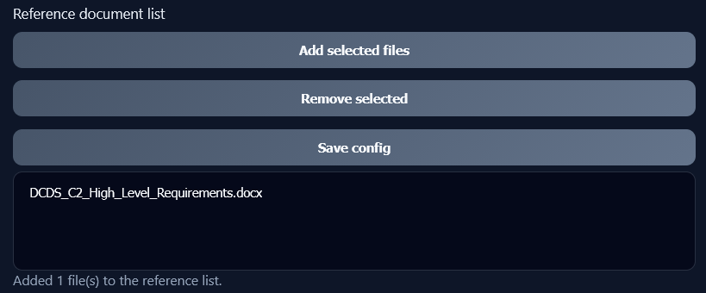
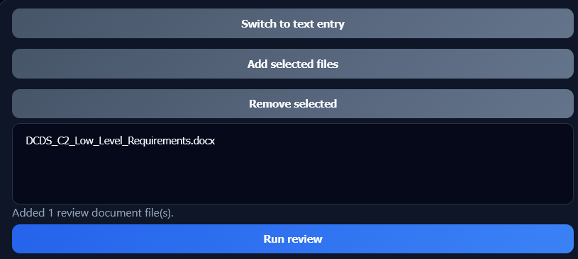
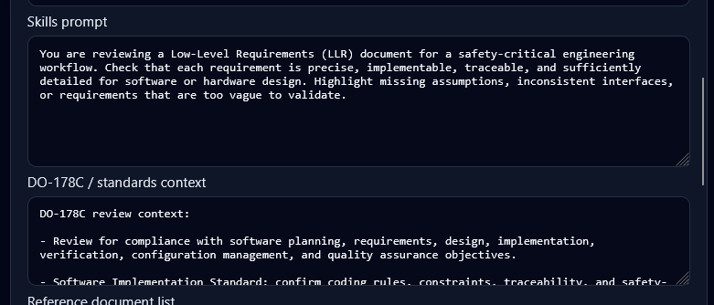

Slide 9
LLR Review
SRATS and HLR provided as requirement context.
Code artefacts documented in this LLR are provided as context.
SIS, SMS included as plans and standards context.
Prompt (skill) included to specify the type of artefact review.
D0-178C context is not provided due to access limitations, but additional standards can be provided for reference.

Slide 10
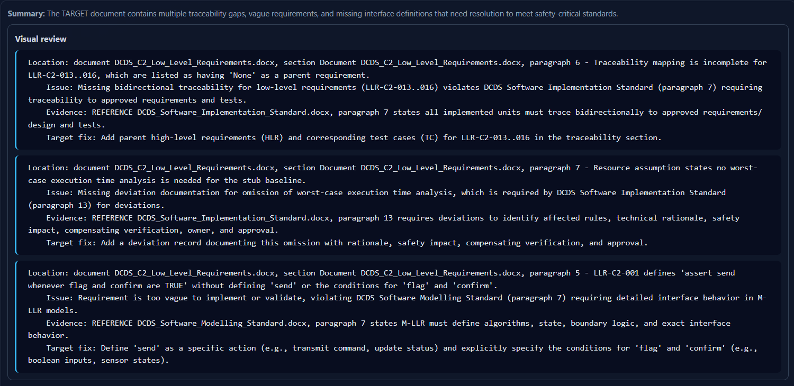

Slide 11
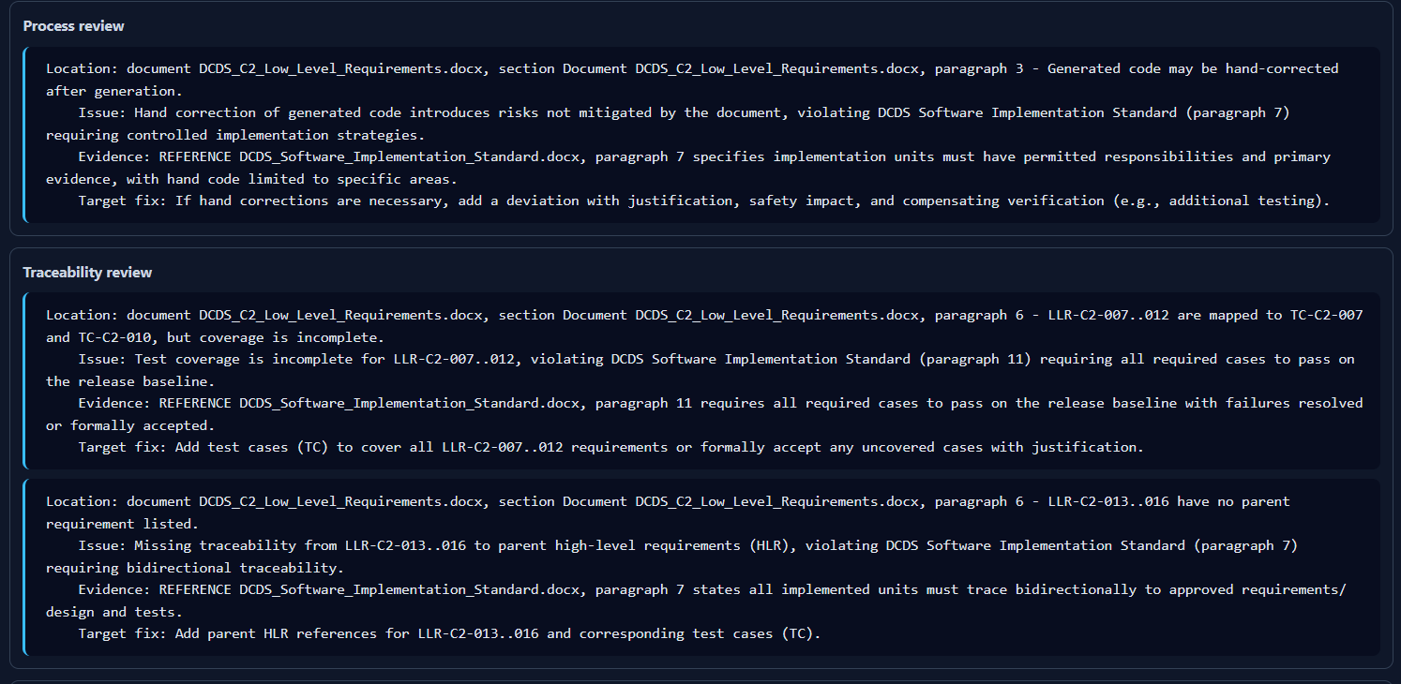

Slide 12
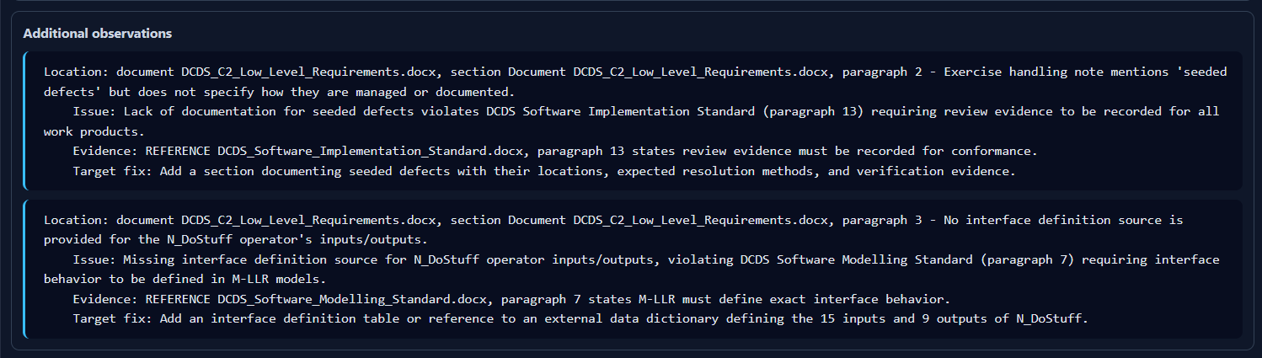

Slide 13
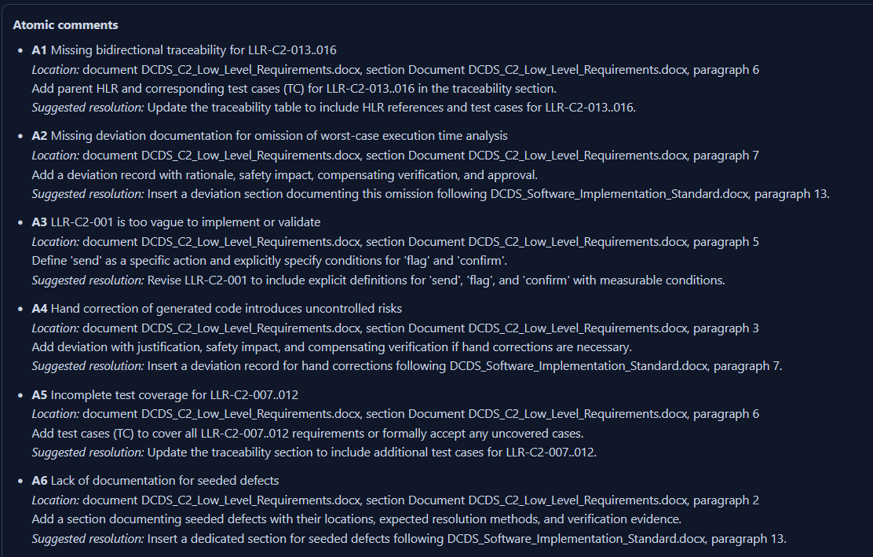

Slide 14
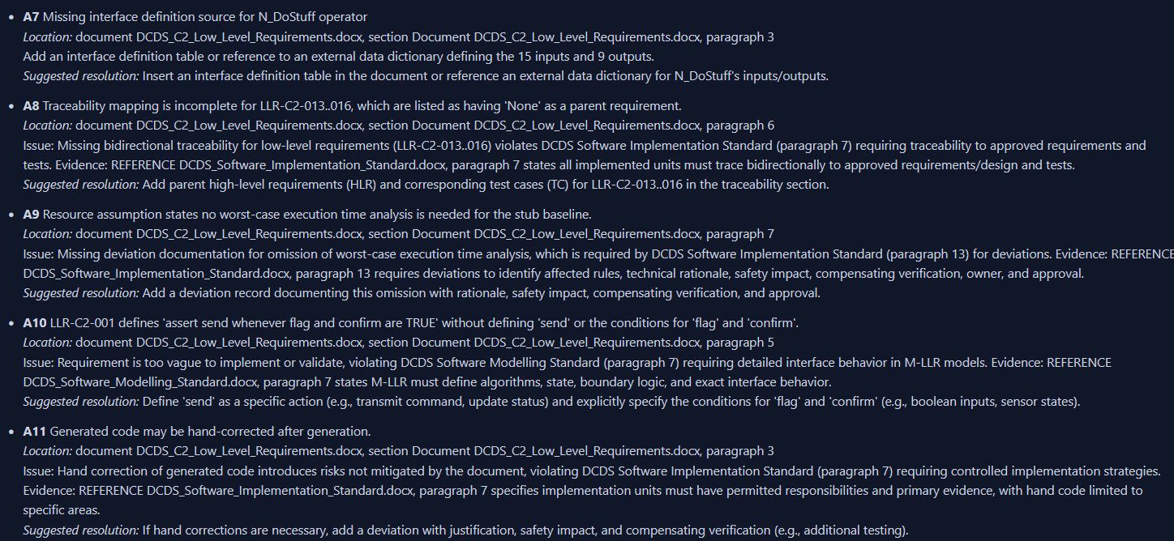

Slide 15
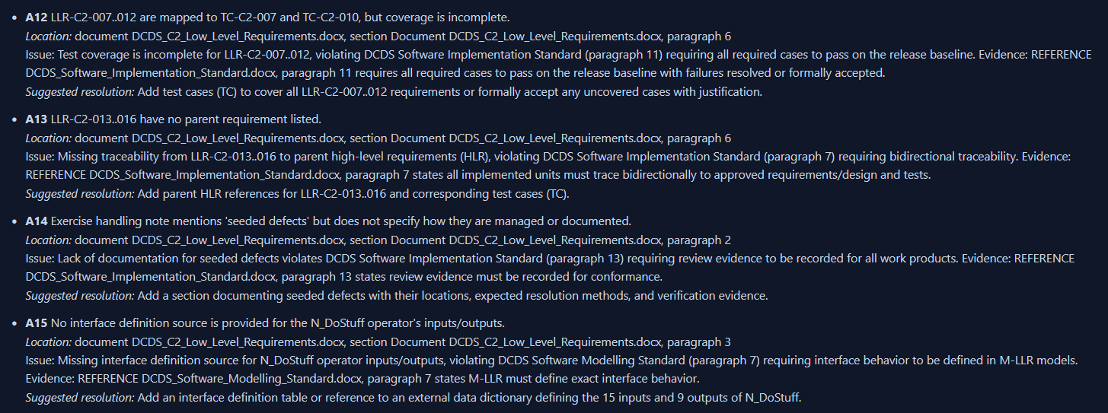

Slide 16
Work to be done
This demo was completed with a smaller, less capable model due to hardware constraints.

Slide 17
As a starting position, the validity of the use of AI to support the review and development of artefacts and code needs to be socialised.
Teams need to be informed around how it can be used, efficiently and properly, for each type of task, either through templated prompting, or work instruction.
I am of the opinion a route needs to be formed for the AI enablement of each established process we use, to speed up familiar, tested and agreed processes.

